Slide 1
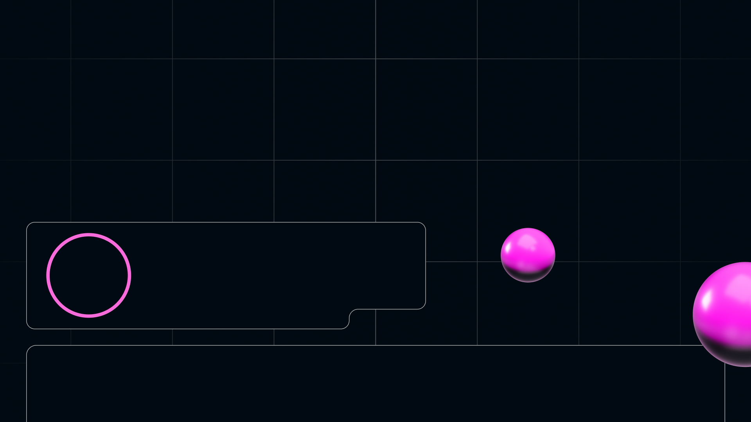
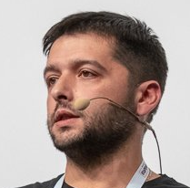


Types in Prototypes
Viktor Vershanskiy
wentout

Slide 2


Slide 3


Slide 4



Slide 5

Bio
JS production at 1999
Back-End на JS в 2000
Node.js с 2009
Diagnostics Group
BUGs Chrome & v8
PMI PMBoK + Agile
PhD in Economy of IT
Виктор
wentout

Slide 6


Slide 7
Outline of the talk
Known TypeScript of HolyJS talks last 3 yrs
Previous talks of this Moonshine Spiritual Journey
Class Based vs Functional Based Constructors
Time Matters the Difference
Real three types of Inheritance in JS ~ TS
Optional Fields Definitions
Identity as a Single Pattern of Chaining

Slide 9
TypeScript on HolyJS

Slide 10
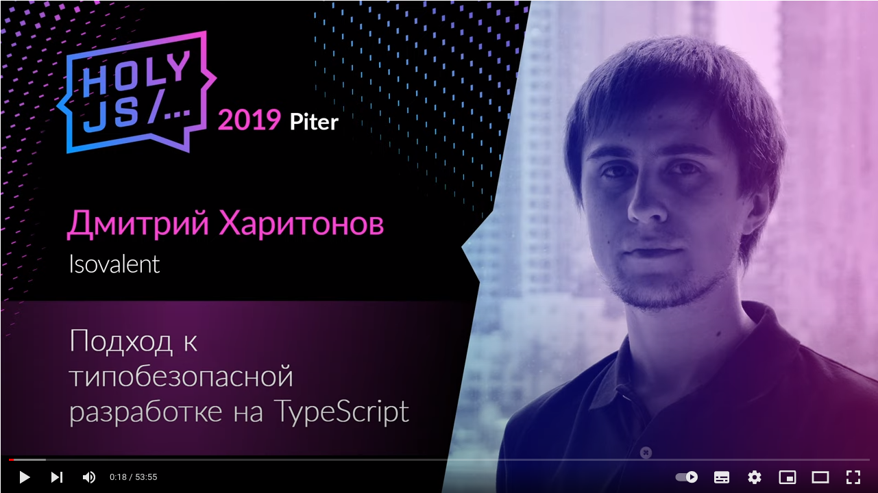
Known TypeScript on HolyJS

Slide 11
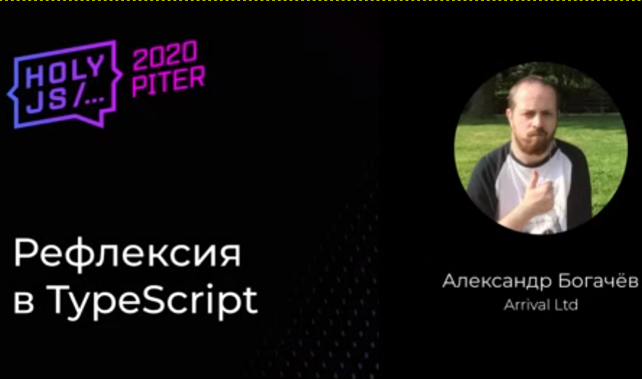
Known TypeScript on HolyJS

Slide 12
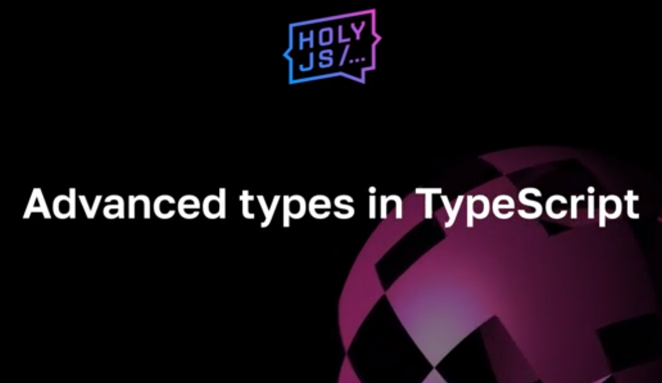
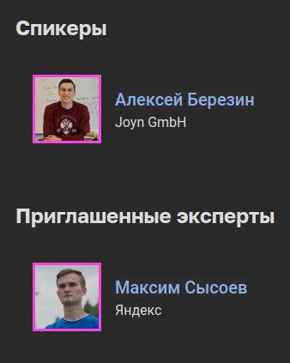
Known TypeScript on HolyJS

Slide 13

Known TypeScript on HolyJS

Slide 14

Known TypeScript on HolyJS

Slide 16
Moonshine Spiritual

Slide 17
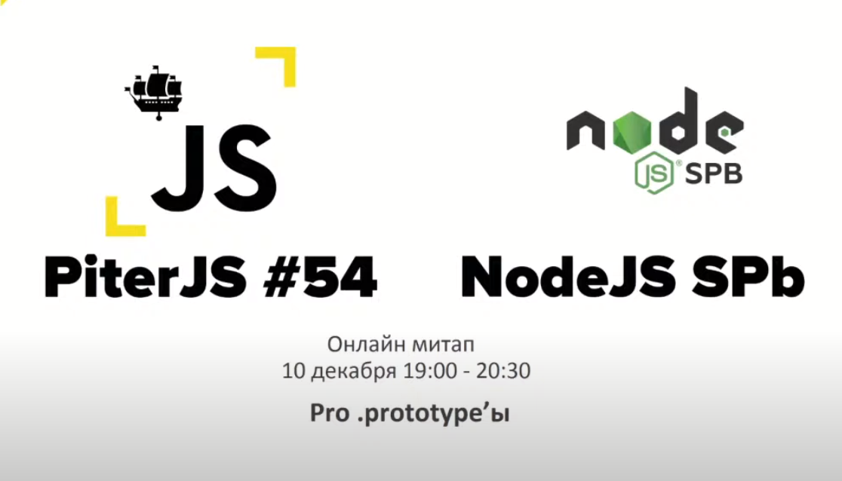
Moonshine Spiritual talks

Slide 18
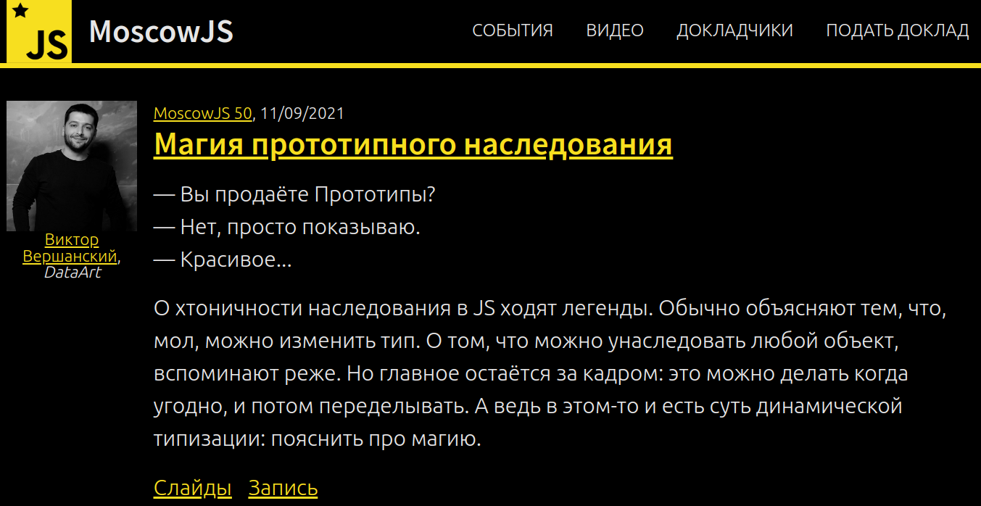
Moonshine Spiritual talks

Slide 19
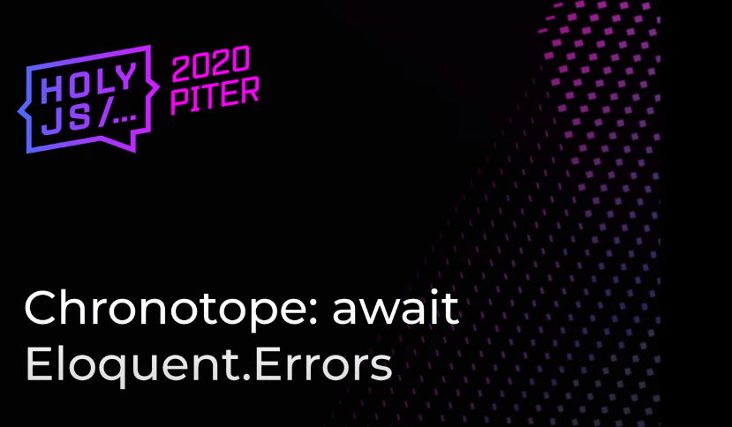
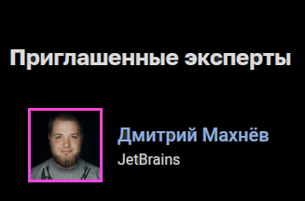
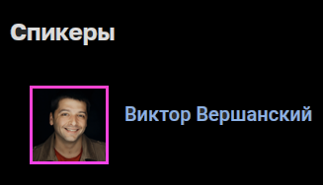
Moonshine Spiritual talks

Slide 20


Moonshine Spiritual talks

Slide 21
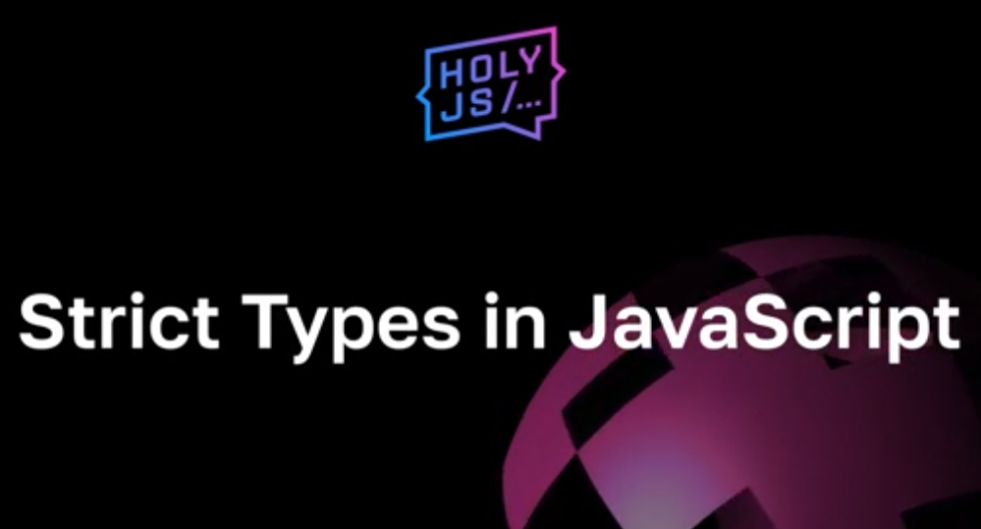
Moonshine Spiritual talks

Slide 22
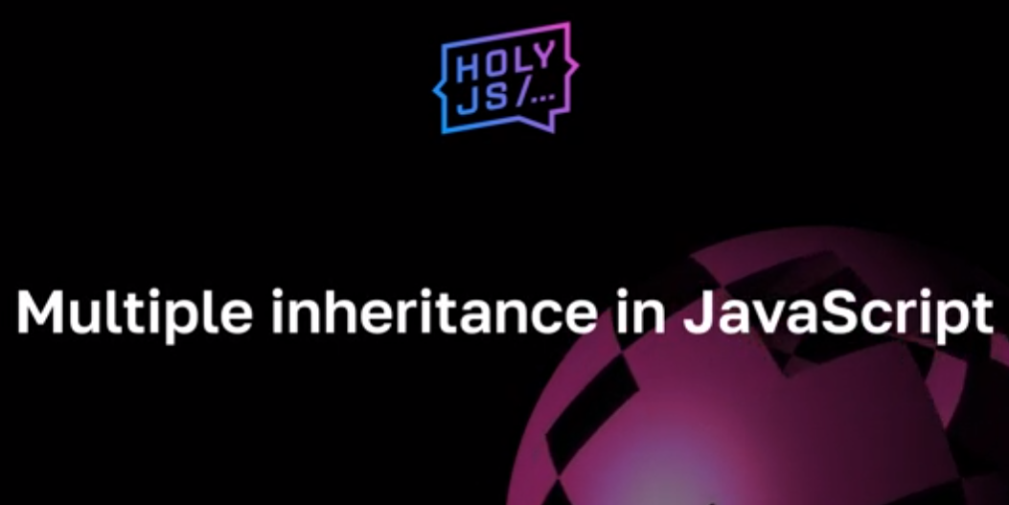
Moonshine Spiritual talks

Slide 24
Class Based vs Functional Based

Slide 25
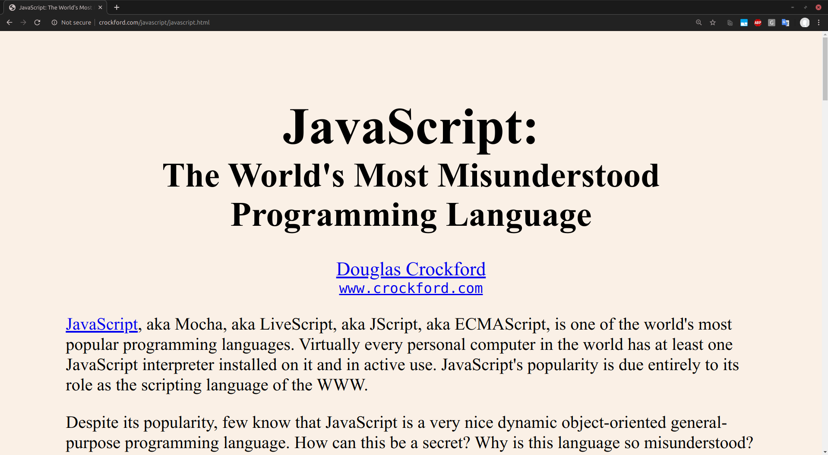
Class vs Function

Slide 26
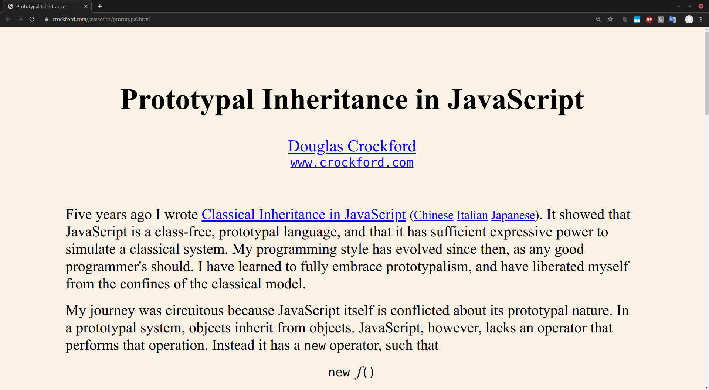
Class vs Function

Slide 27
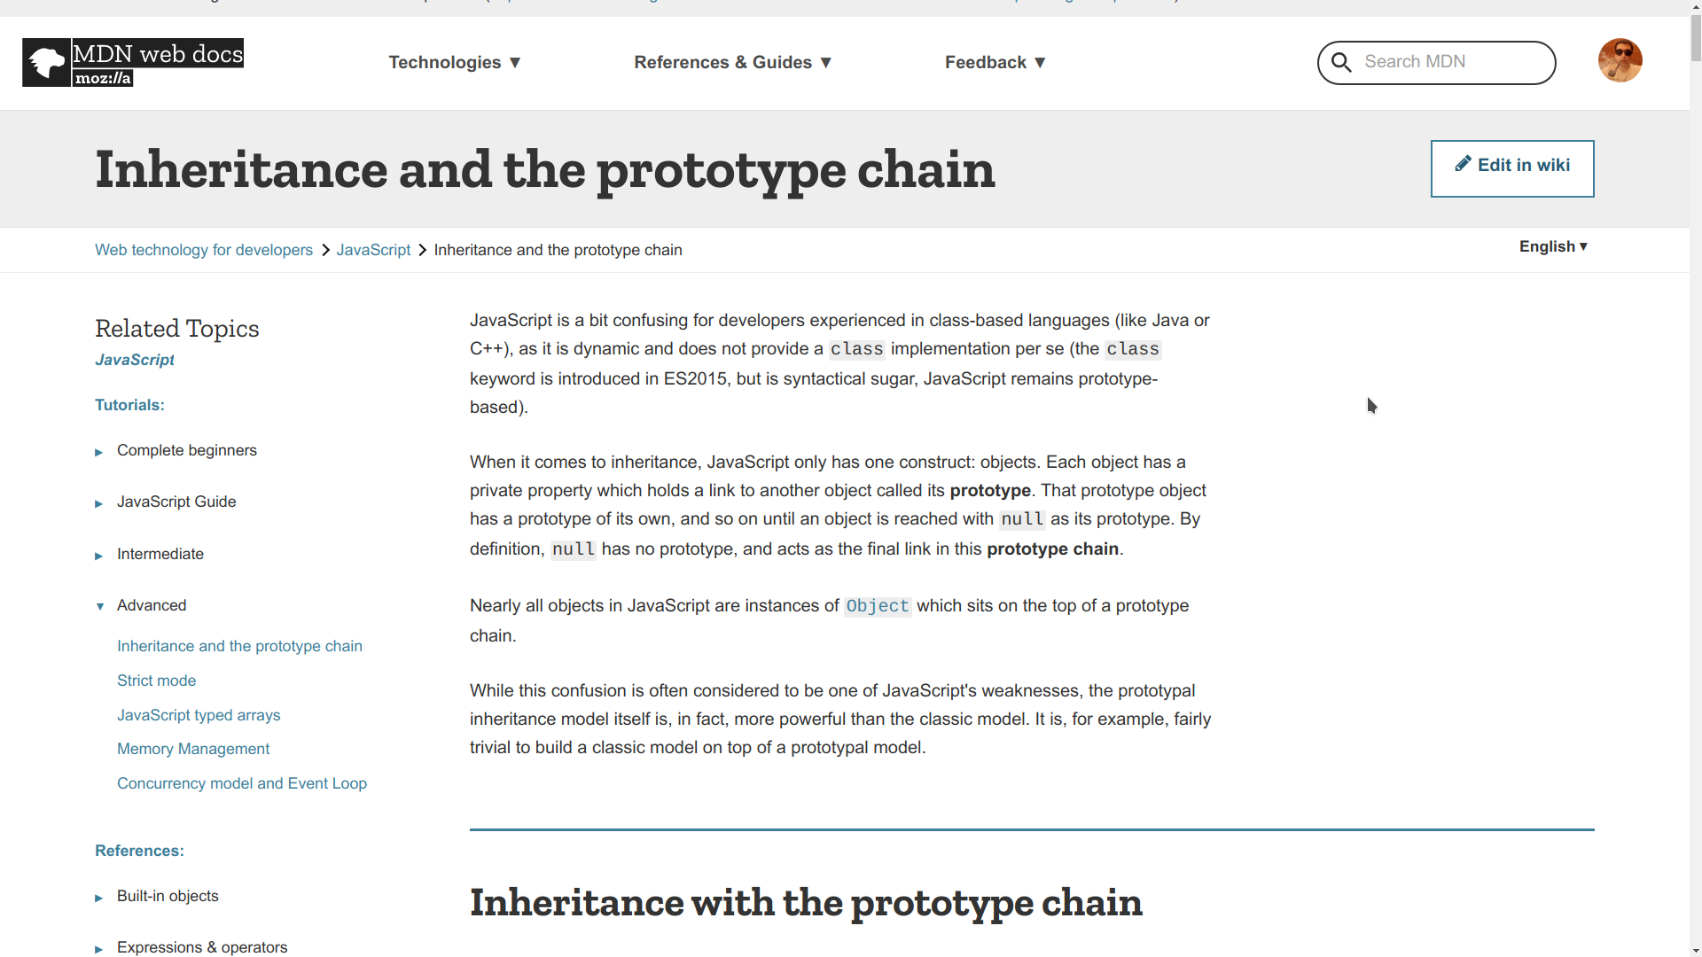
Class vs Function

Slide 28
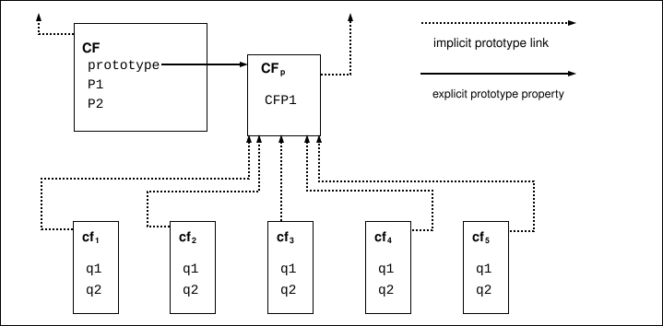
Class vs Function

Slide 29
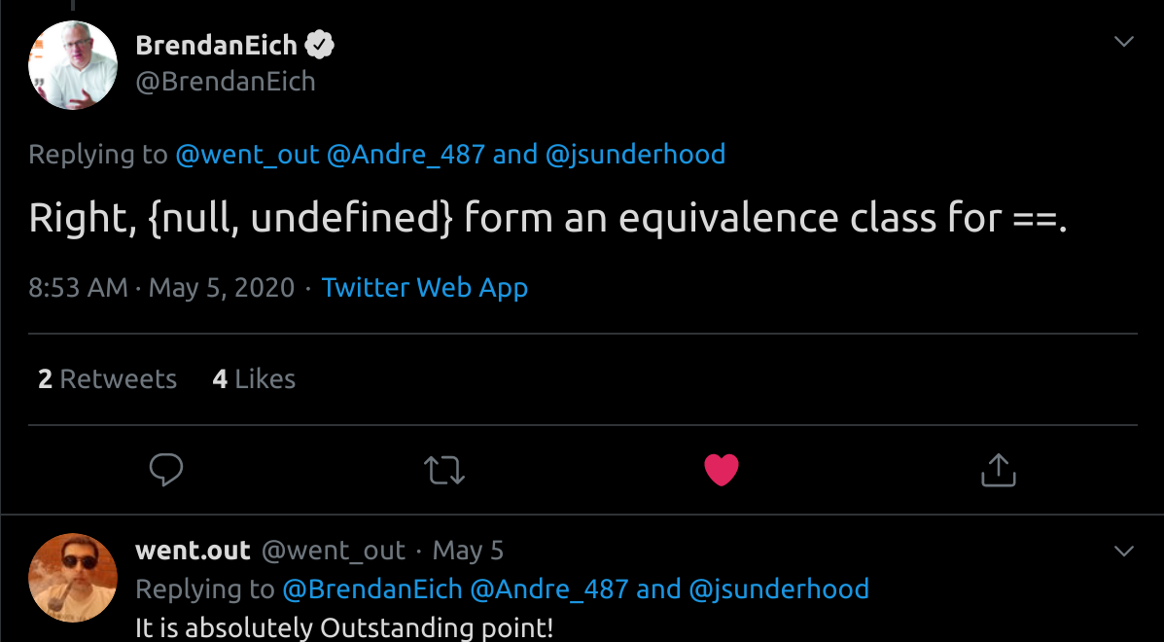
Class vs Function

Slide 30
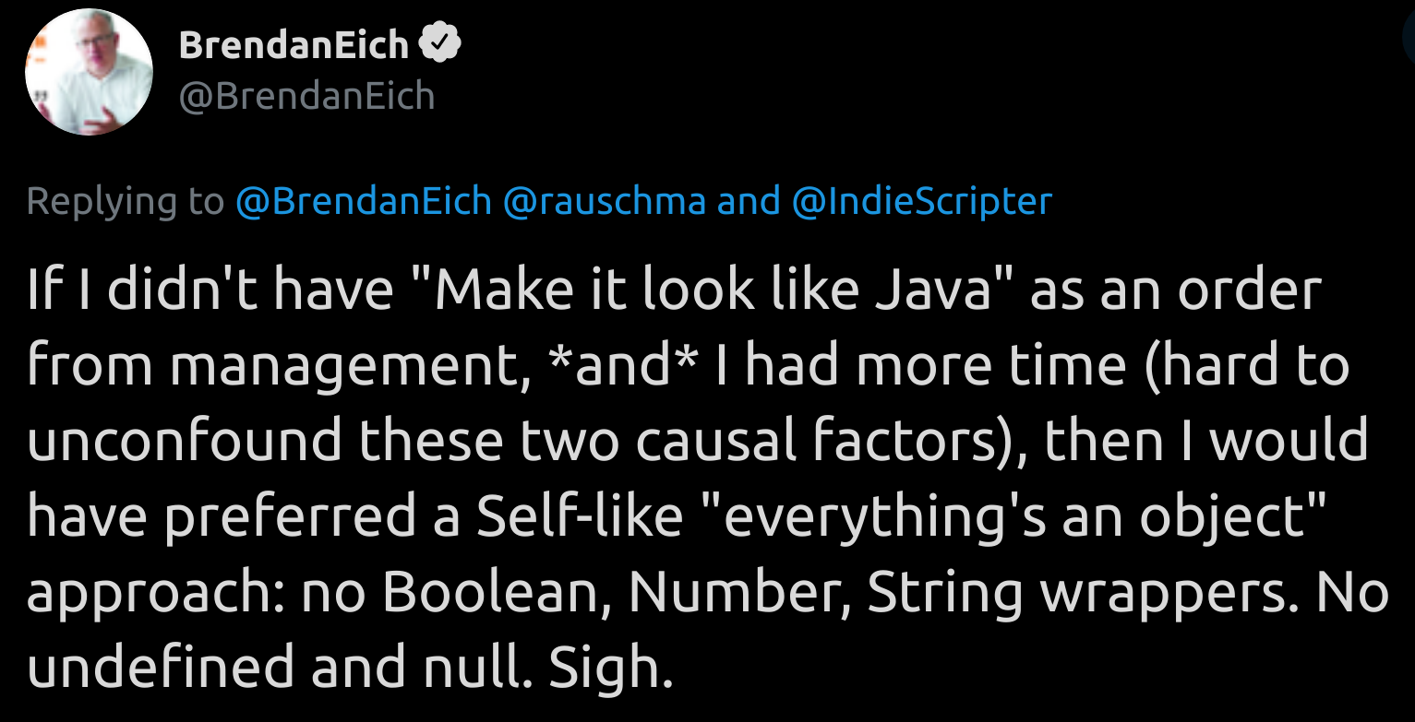
Class vs Function

Slide 31
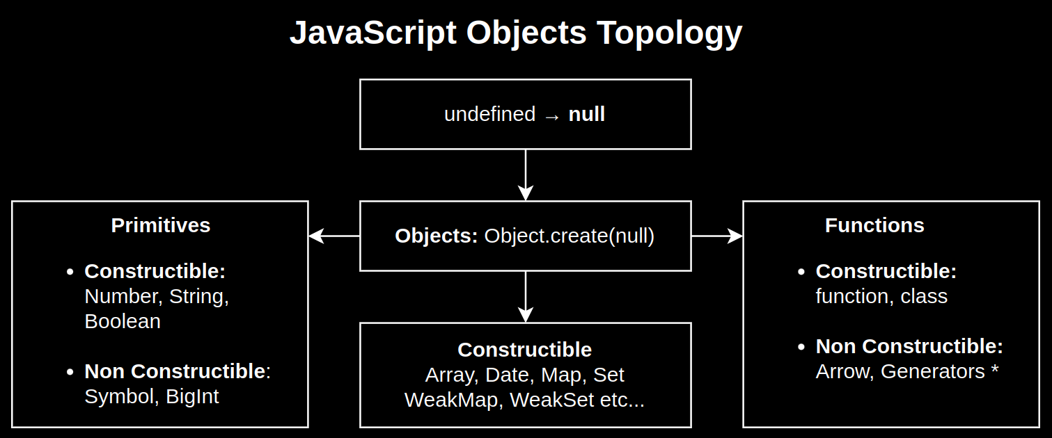
Class vs Function

Slide 32
Class vs Function

Slide 33
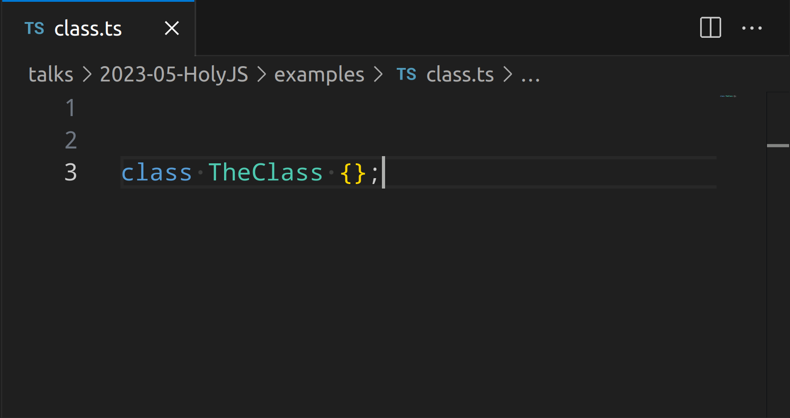
Class vs Function

Slide 34
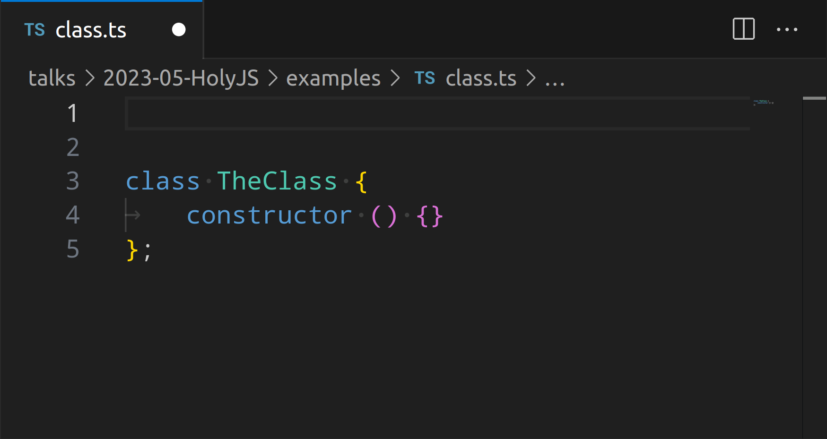
Class vs Function

Slide 35
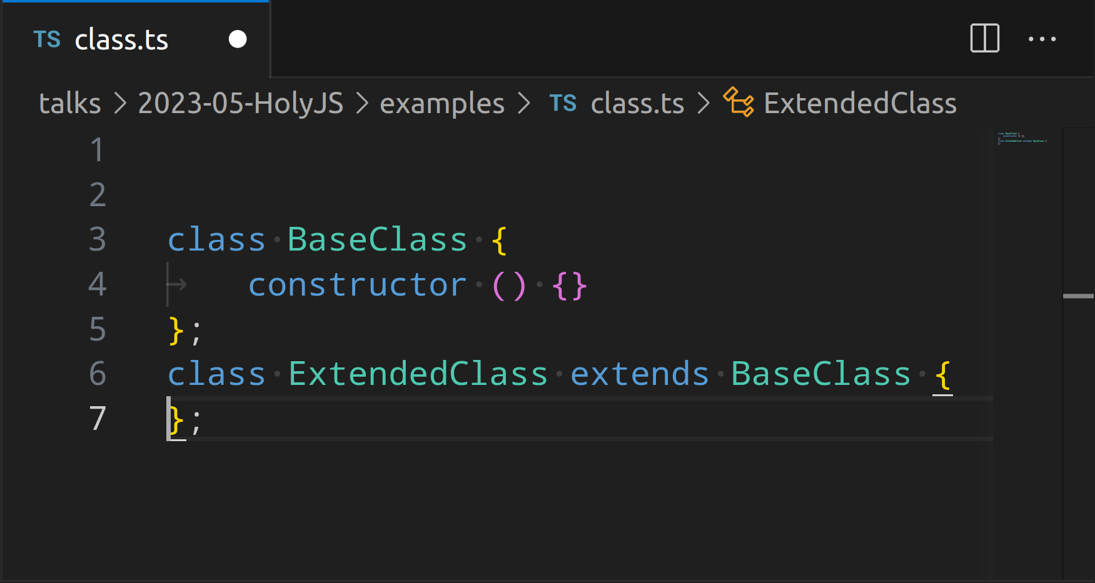
Class vs Function

Slide 36
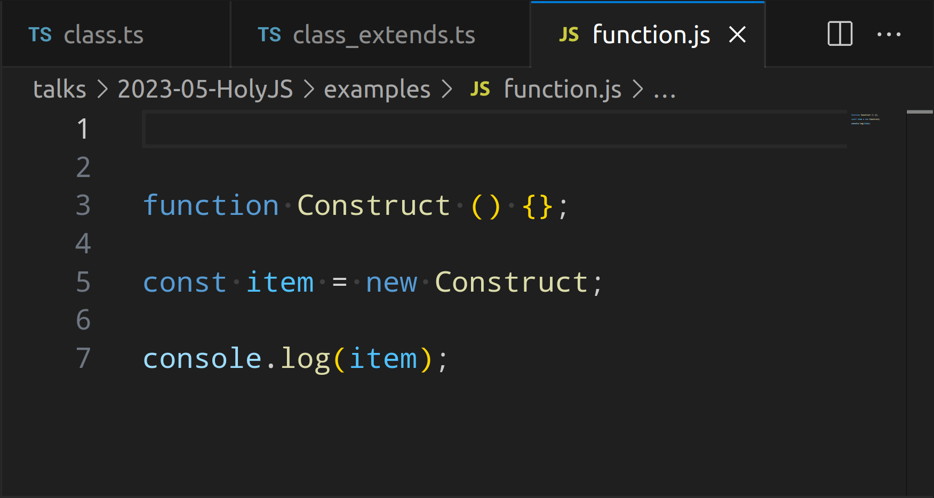
Class vs Function

Slide 37
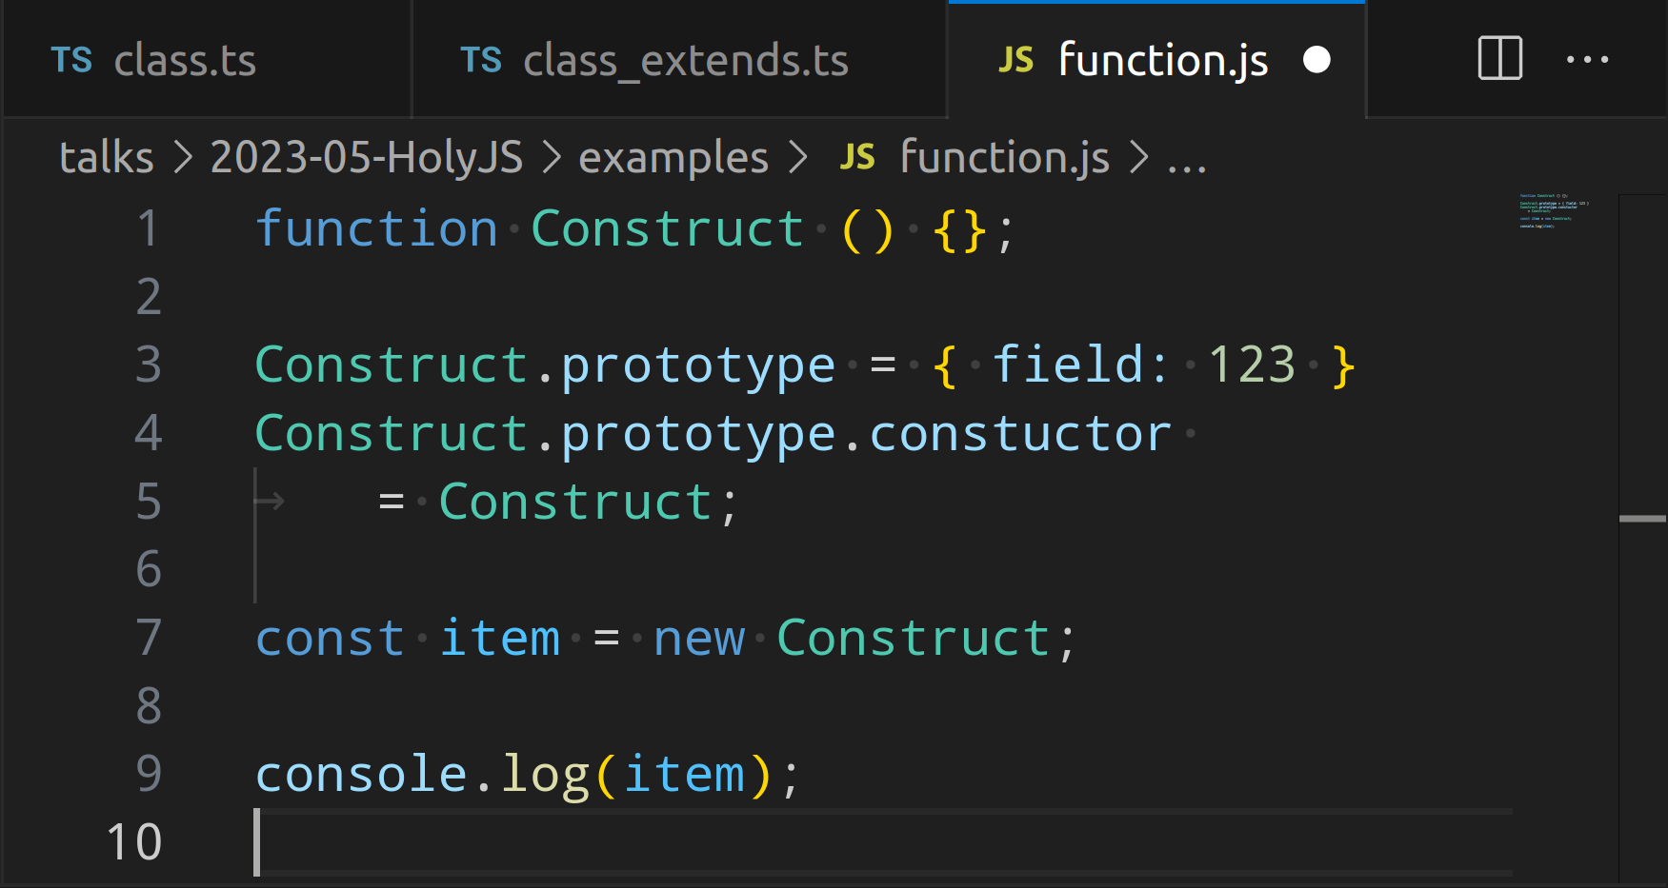
Class vs Function

Slide 39
time matters the difference

Slide 40
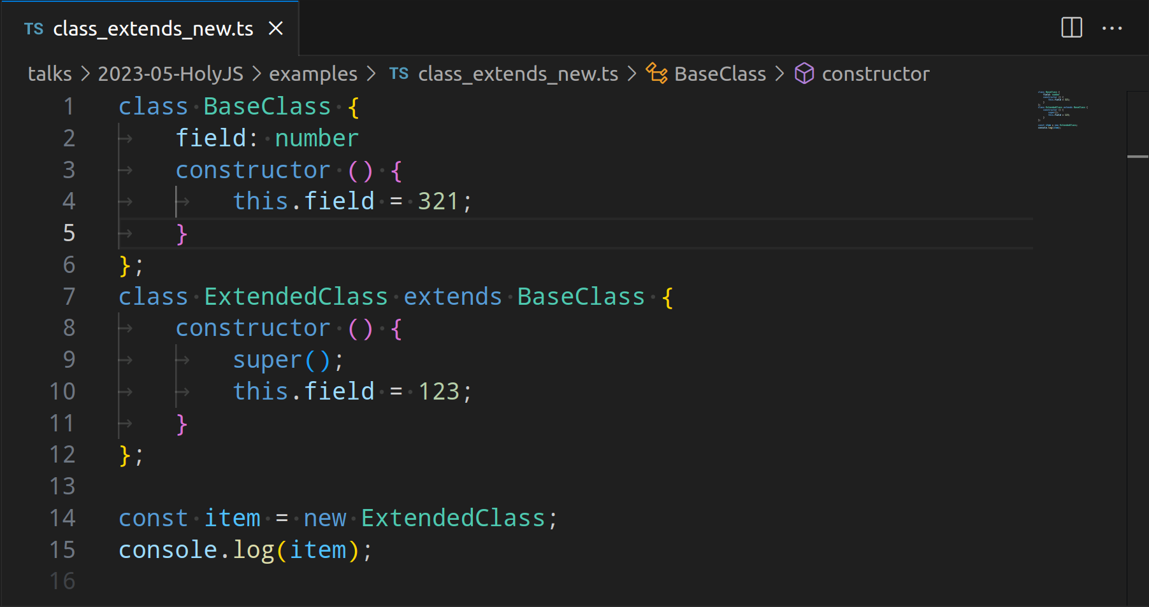
Time Matters

Slide 41
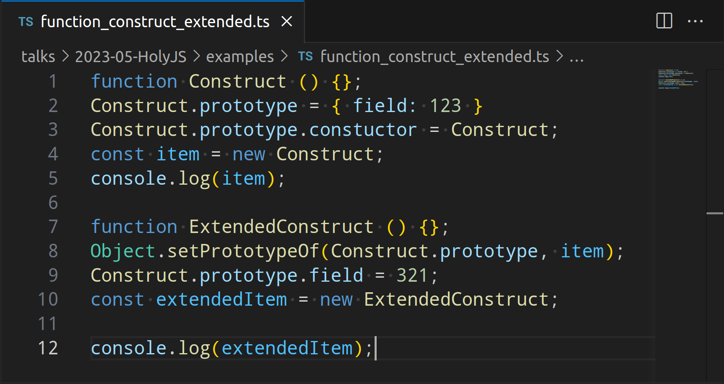
Time Matters

Slide 42

Time Matters

Slide 43
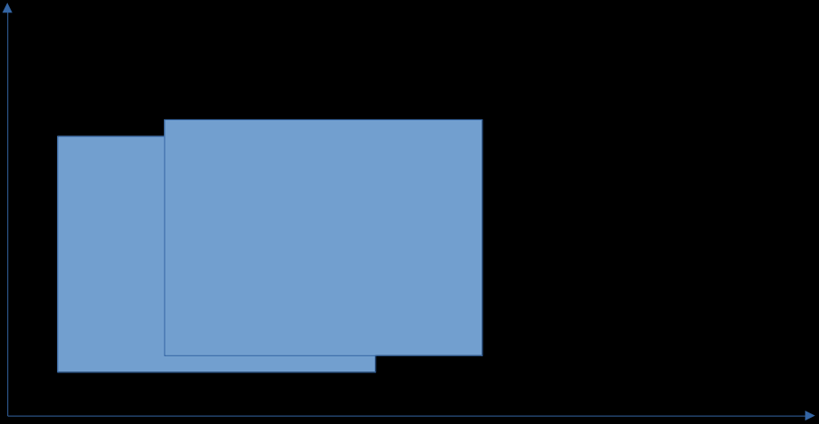
Time Matters

Slide 44
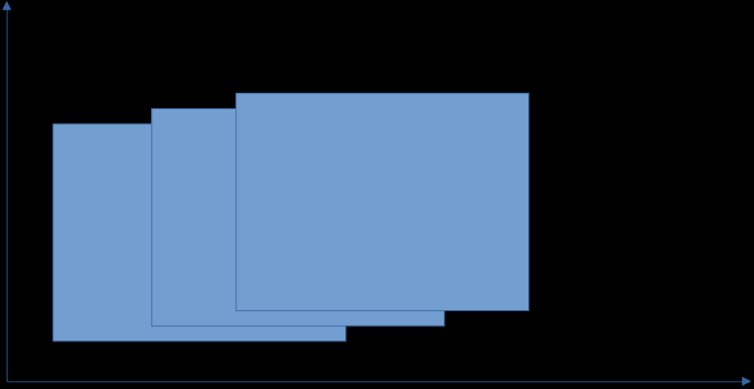
Time Matters

Slide 45
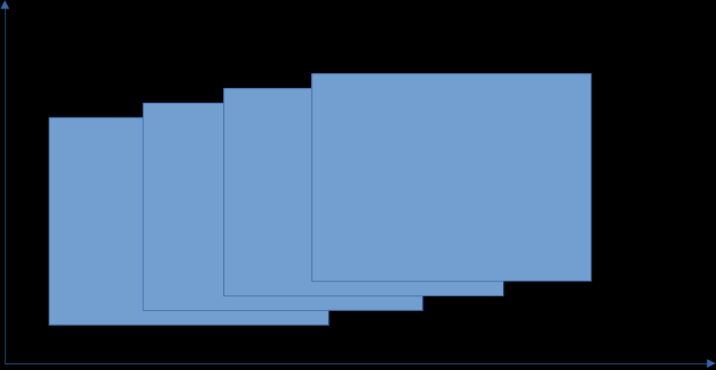
Time Matters

Slide 46
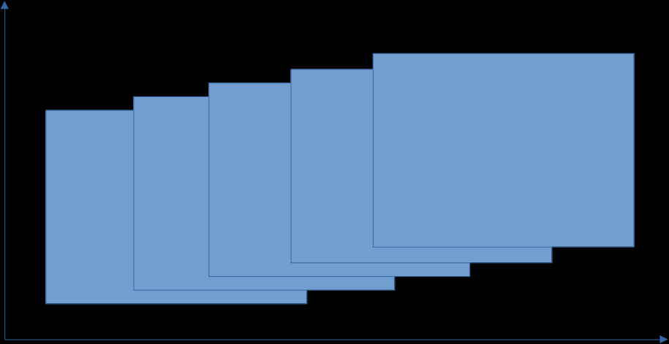
Time Matters

Slide 47
Time Matters

Slide 48
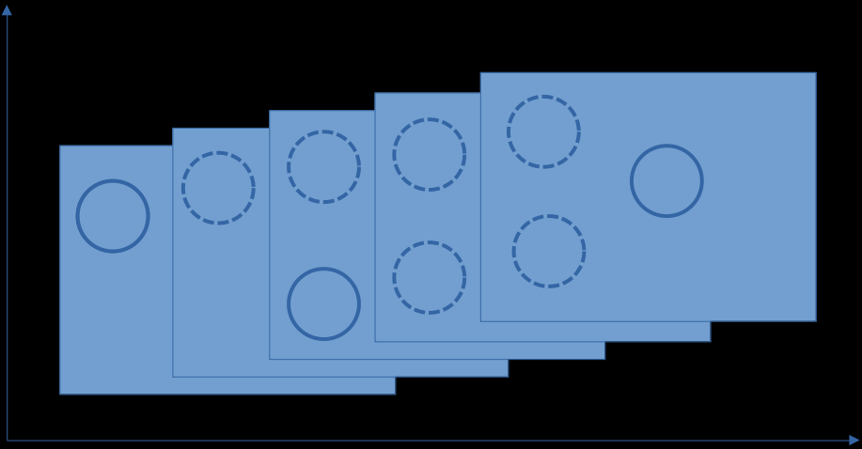
Time Matters

Slide 49

Time Matters

Slide 50
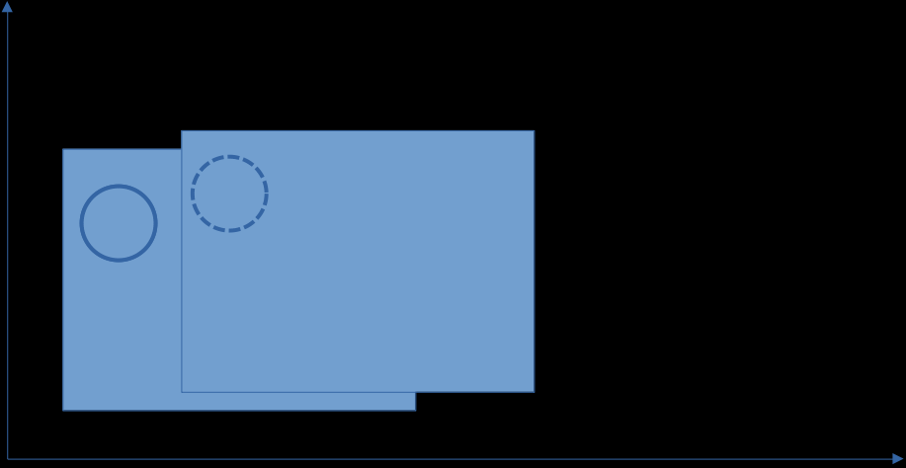
Time Matters

Slide 51

Time Matters

Slide 52
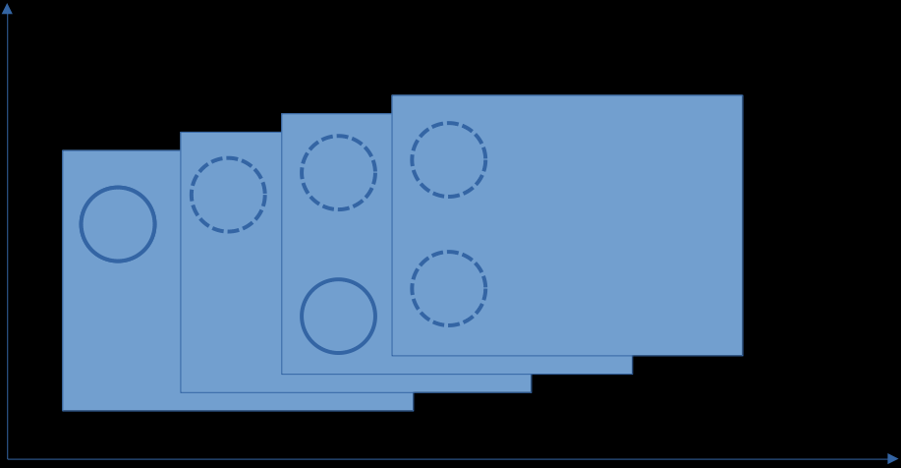
Time Matters

Slide 53
Time Matters

Slide 54
Class vs Function

Slide 55
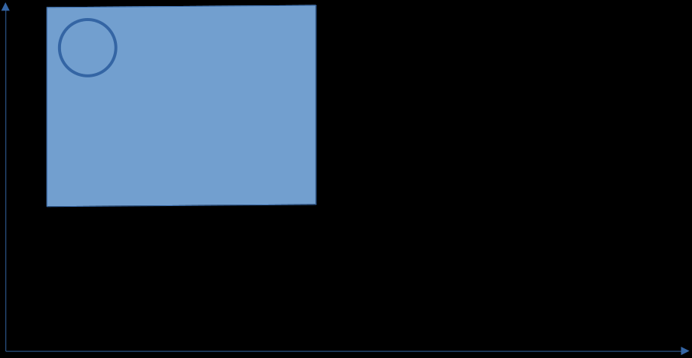
Time Matters

Slide 56
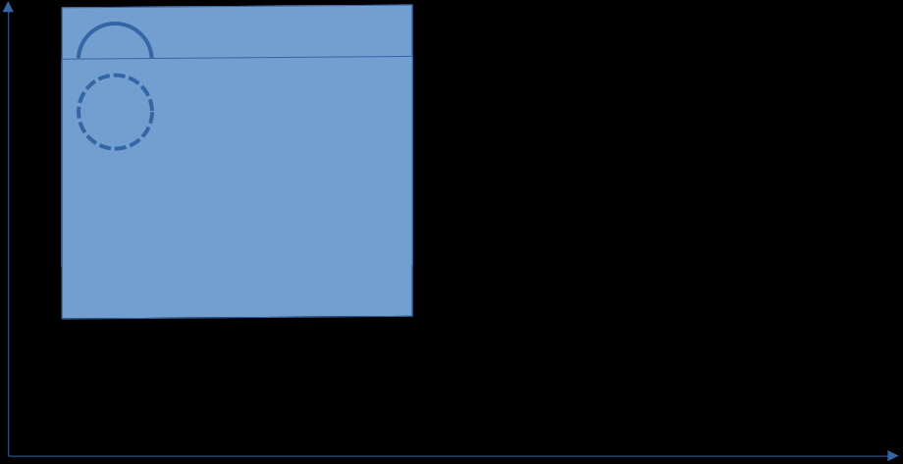
Time Matters

Slide 57
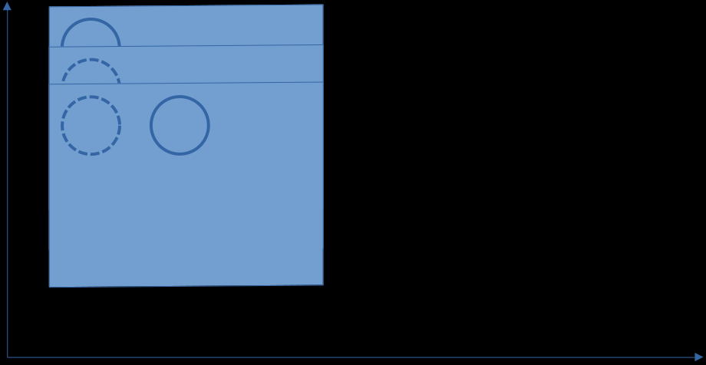
Time Matters

Slide 58
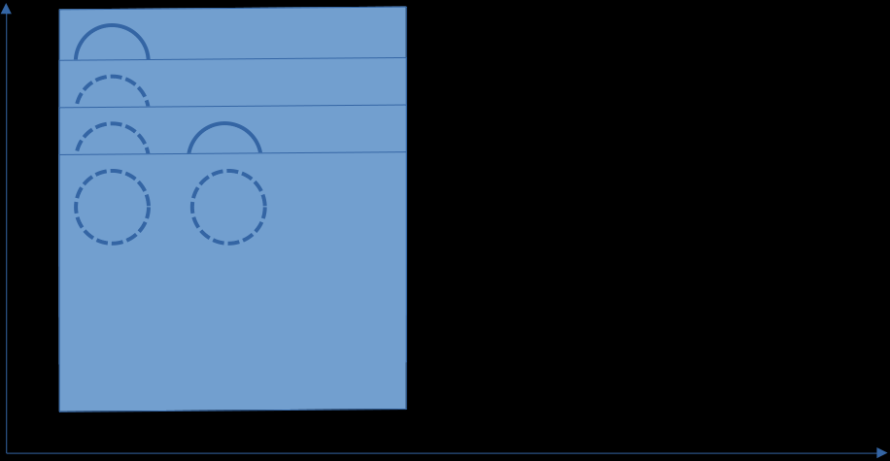
Time Matters

Slide 59
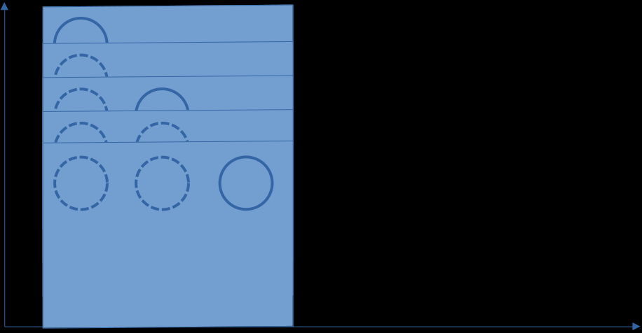
Time Matters

Slide 60
Time Matters

Slide 61
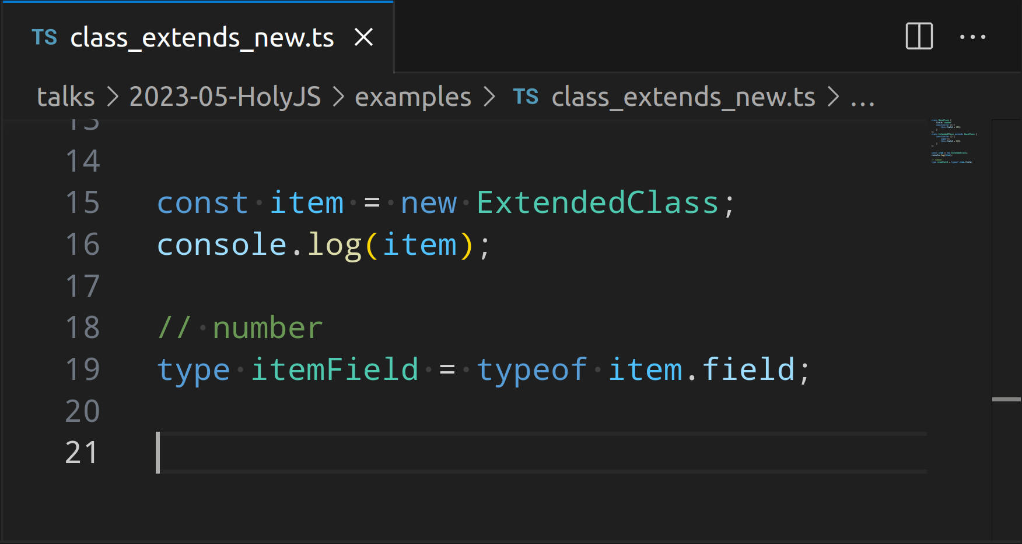
Time Matters

Slide 62
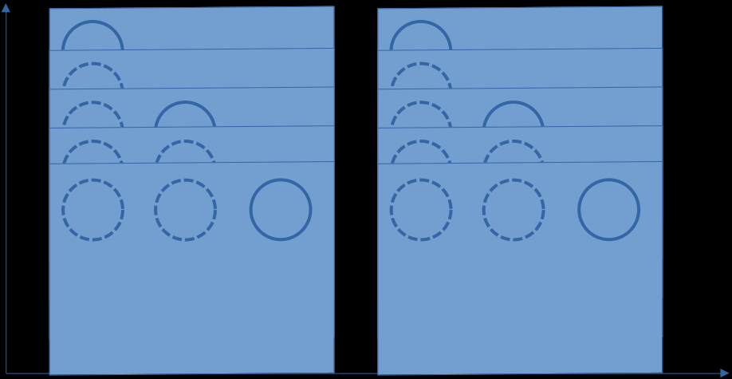
Time Matters

Slide 64
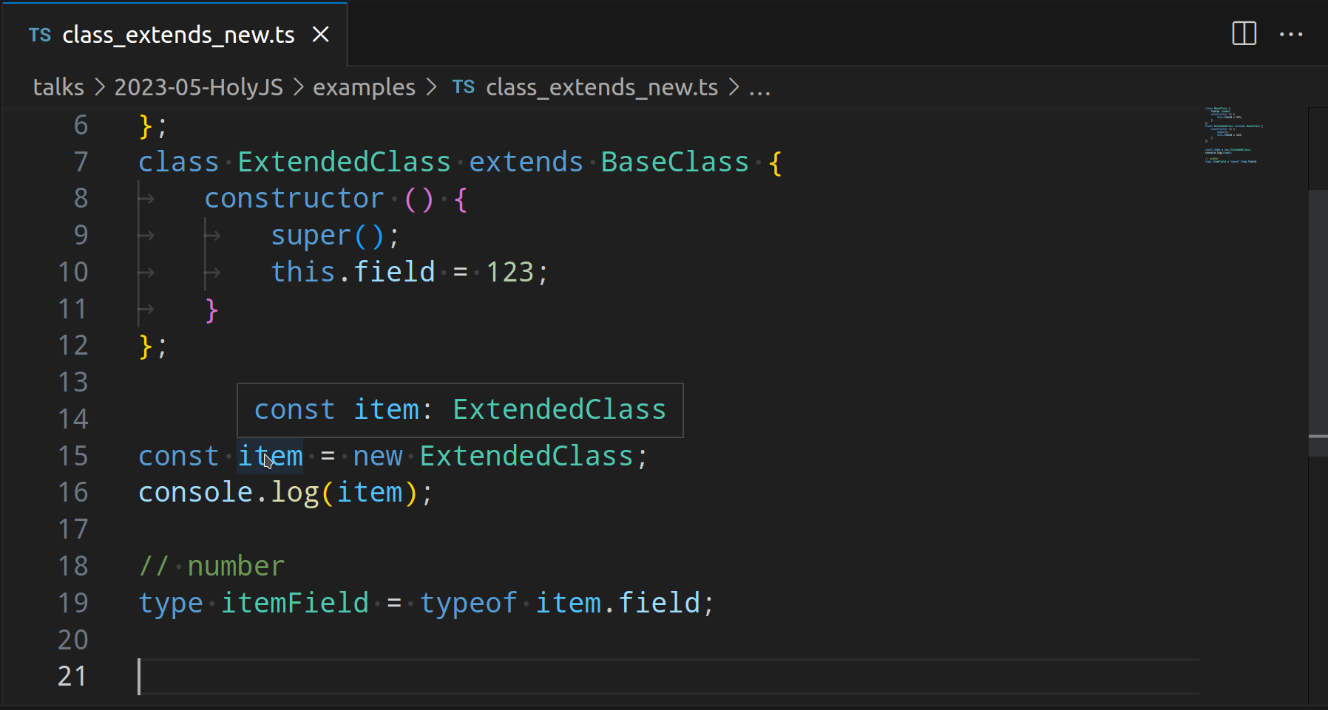
Time Matters

Slide 65
Time Matters

Slide 66
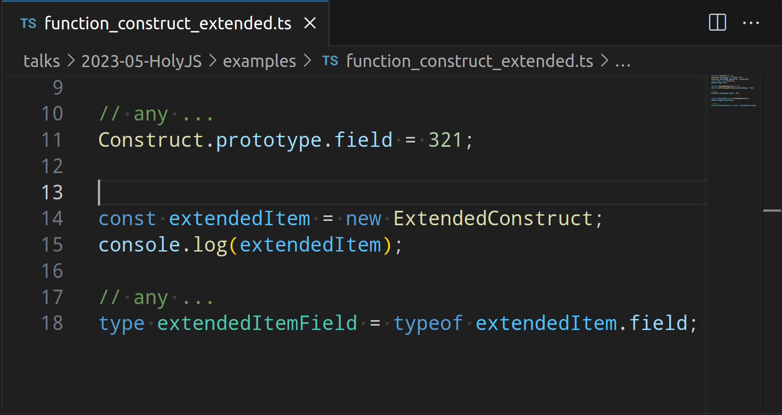
Time Matters

Slide 67
Time Matters

Slide 69
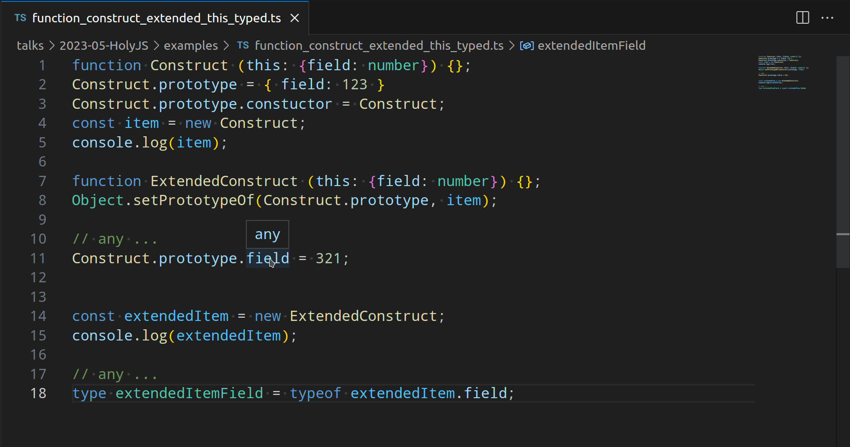
Time Matters

Slide 70
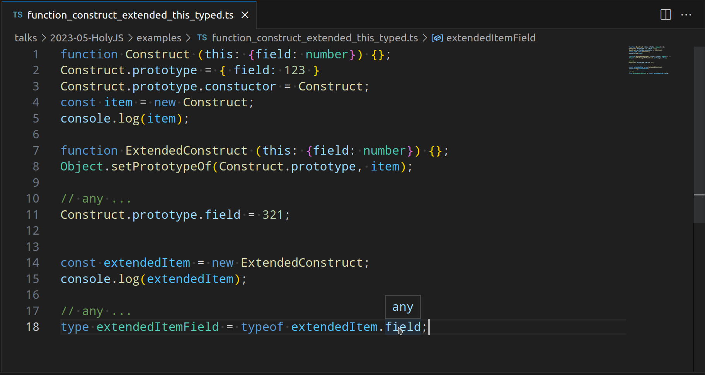
Time Matters

Slide 72
types of Inheritance in JS~TS

Slide 73
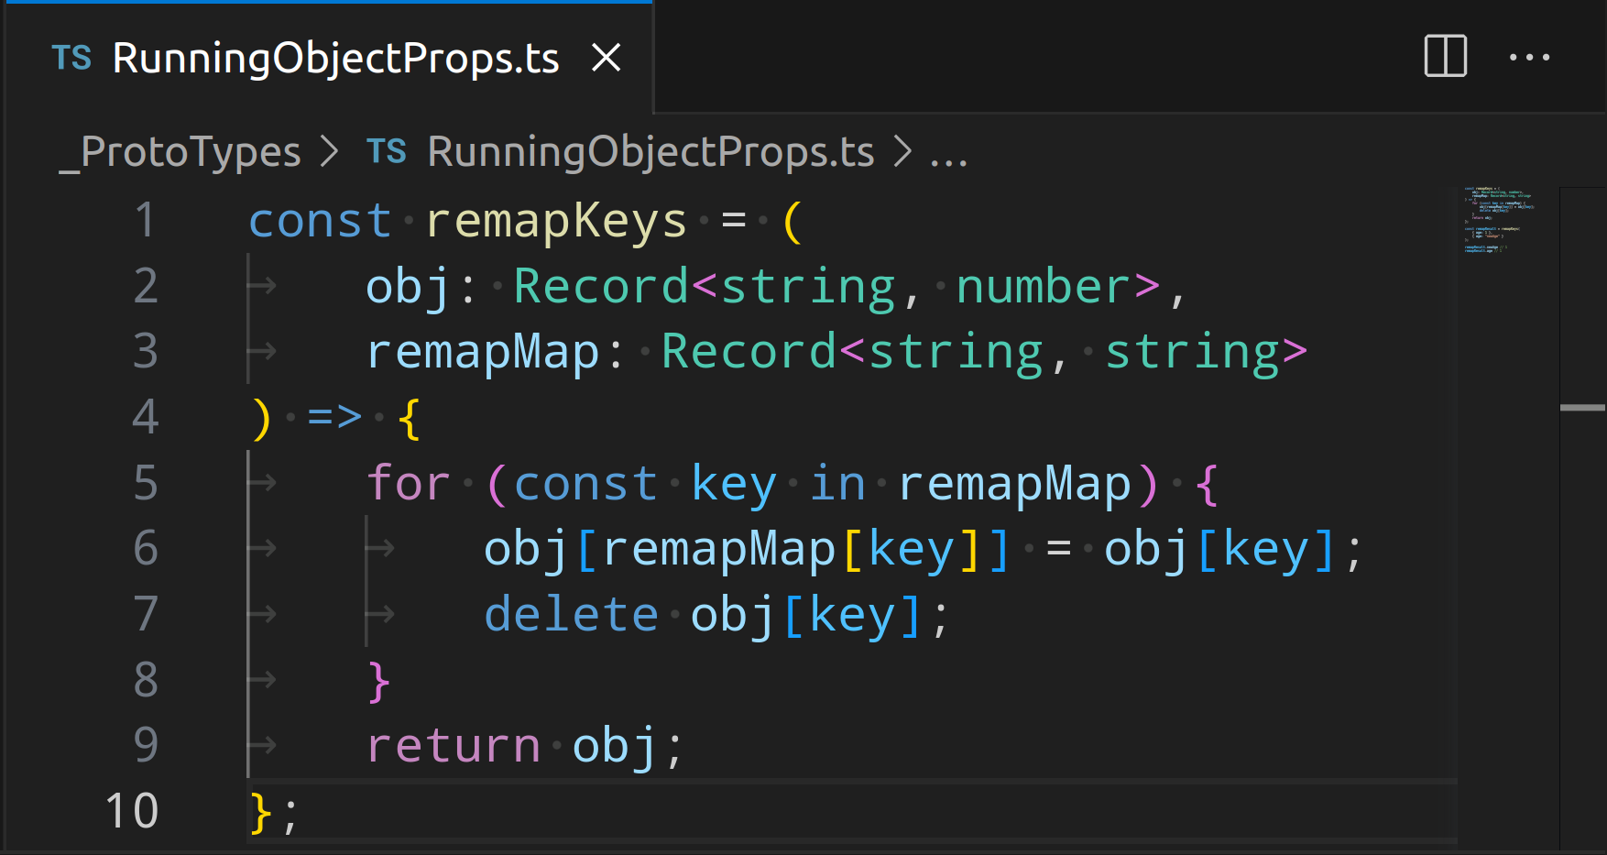
types of Inheritance

Slide 74
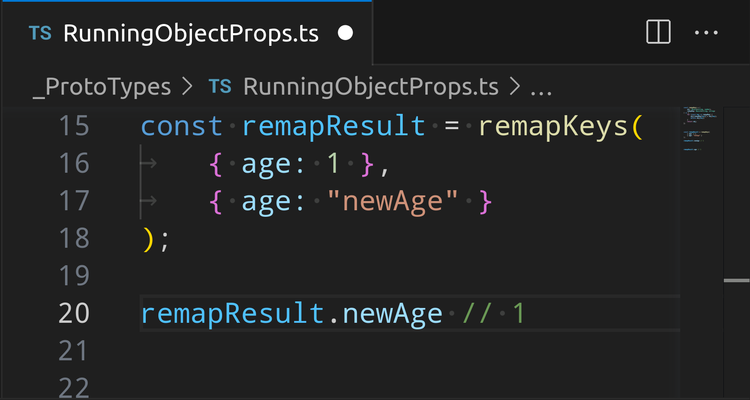
types of Inheritance

Slide 75
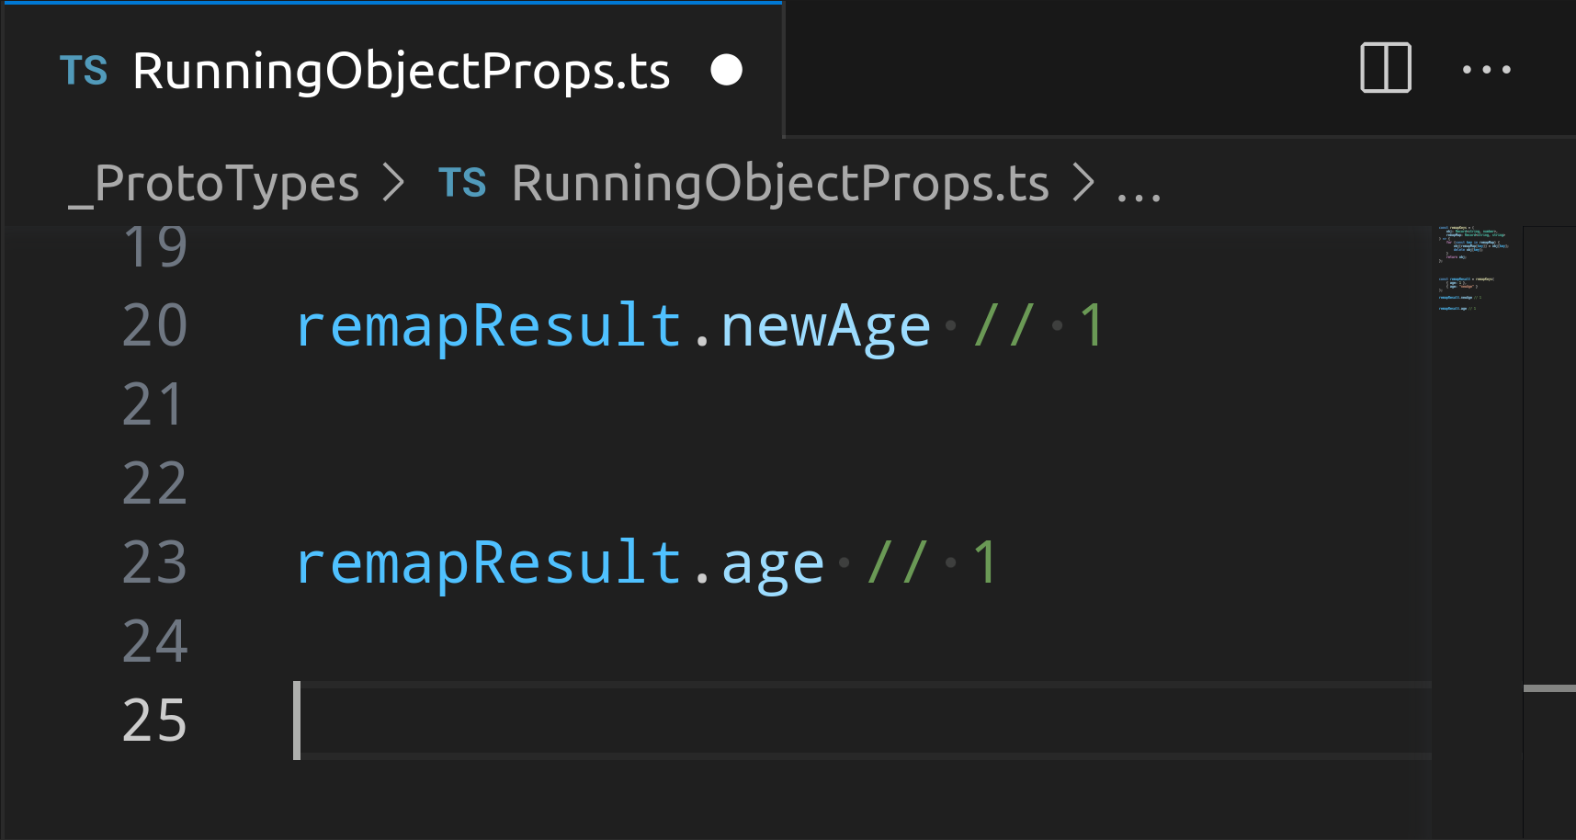
types of Inheritance

Slide 76
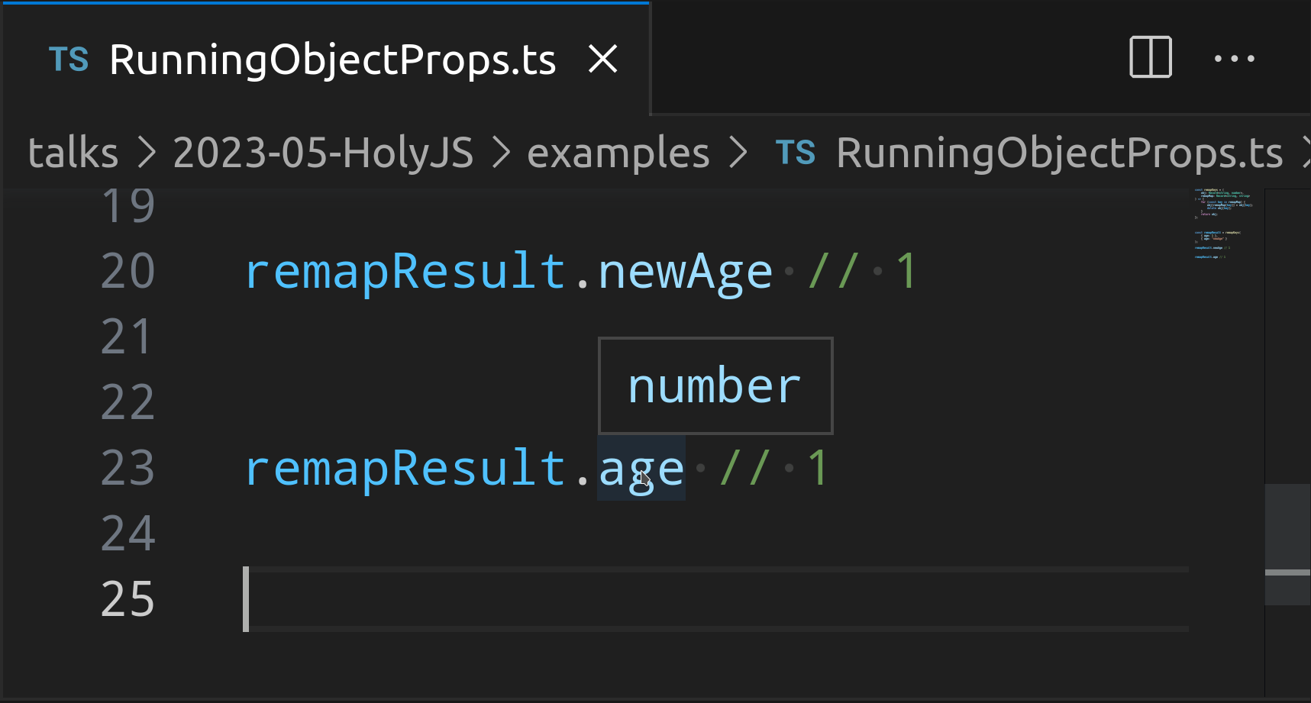
types of Inheritance

Slide 77
types of Inheritance
it is not the thing you think about …
Primitive to Primitive
Primitive to Object
Object to Primitive
Object to Object

Slide 78
types of Inheritance
it is not the thing you think about …
Primitive to Primitive
Primitive to Object
Object to Primitive
Object to Object
DEMO

Slide 80
Optional Fields Definitions

Slide 81
optional fields …

Slide 82
optional fields …
again is not the usual thing …
get ~ set only fields
and this might be deep …
and mixed with Primitive | Object

Slide 83
optional fields …
again is not the usual thing …
get ~ set only fields
and this might be deep …
and mixed with Primitive | Object
DEMO

Slide 85
Identity of Chaining

Slide 86
identity of chaning

Slide 88
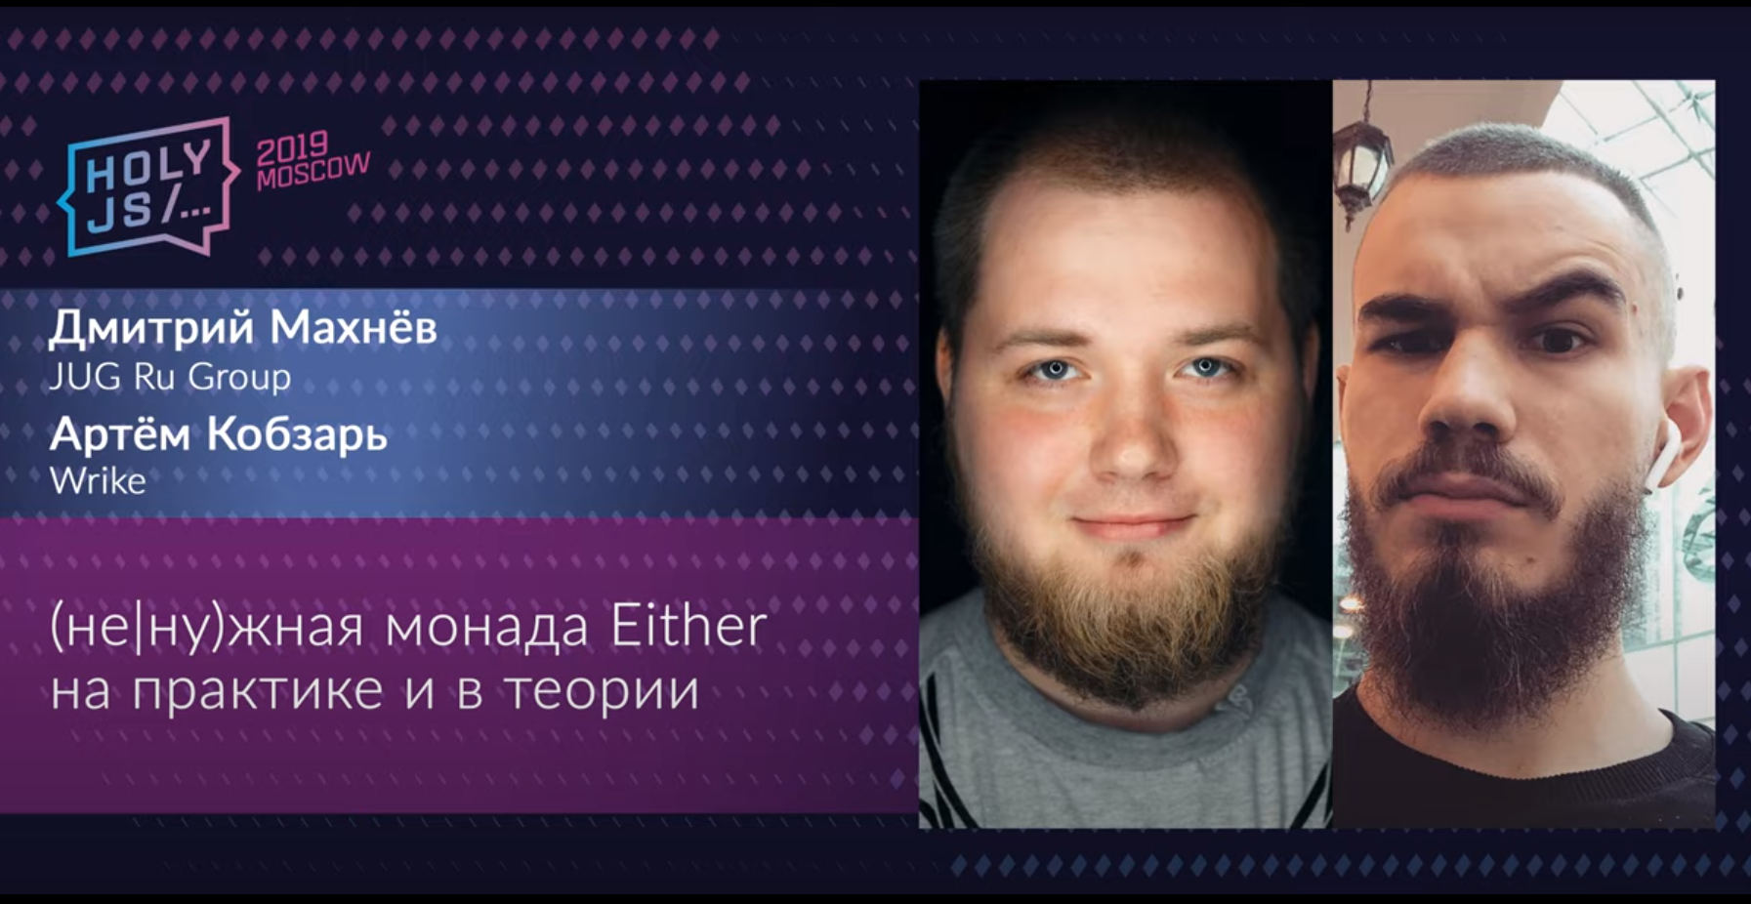
special thanks to

Slide 89

special thanks to

Slide 90
next talk announce
Mnemonica Project
Viktor Vershanskiy
wentout

